Slide 1
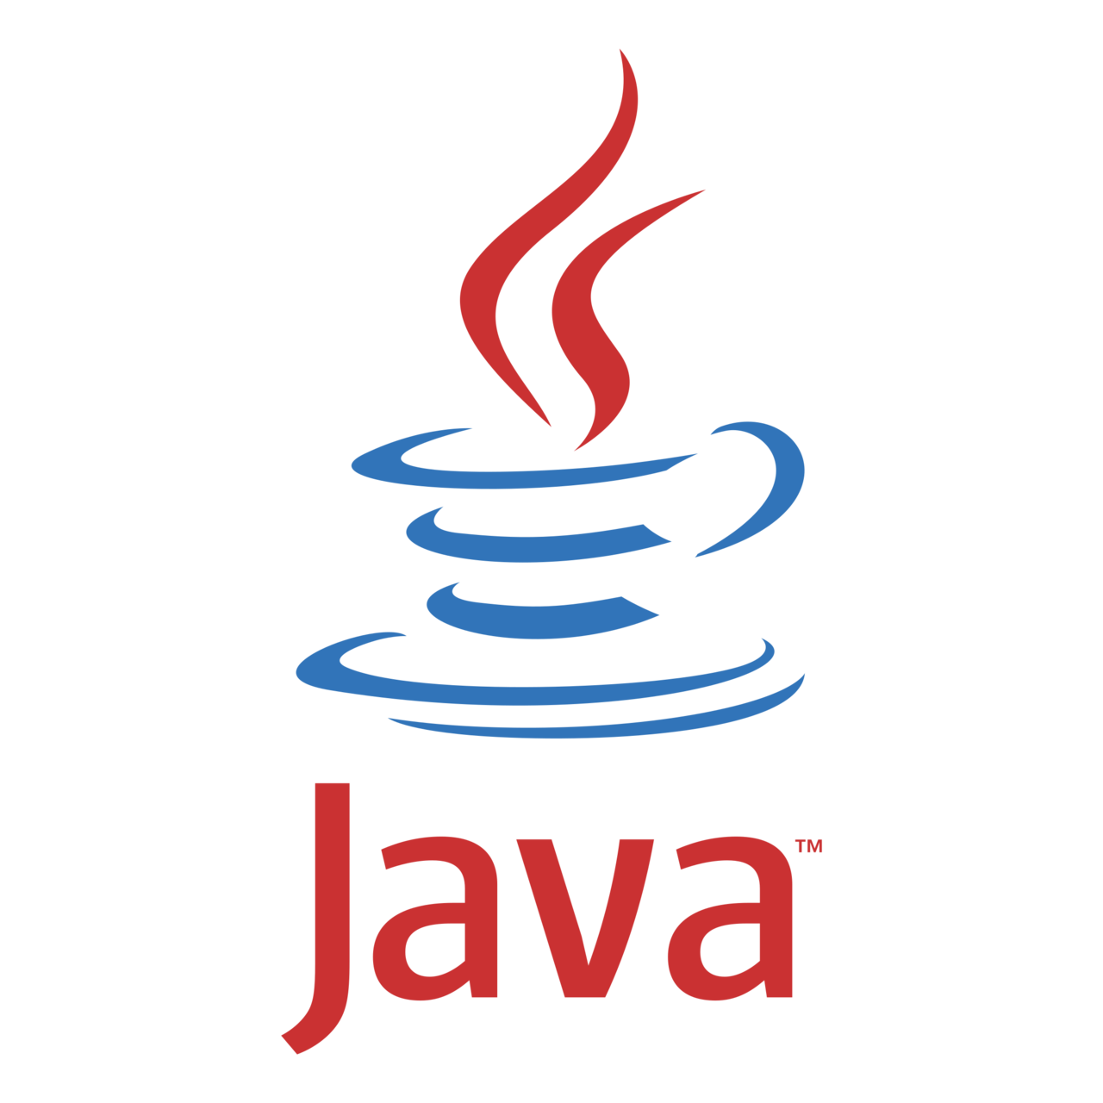
Java Workshop

Slide 2

HELLO!
I am Priyanshu Upadhyay
Competitive Programmer | React Developer | Python Developer | Security Researcher

Slide 3
How this session is different ?

Slide 4
Why Java Programming ?
It’s almost entirely object-oriented
It has a vast library of predefined objects and operations
It’s more platform independent
It’s more secure
Java can be embedded in Web pages

Slide 5
Let’s Setup Java
Download JDK from Oracle.com
Setting Up Environment Variables.

Slide 6
Java Processing and Execution
Begin with Java source code in text files: abc.java
A Java source code compiler produces Java byte code
Outputs one file per class: abc.class
A Java Virtual Machine loads and executes class files
Bytecode is like machine language, but it is intended for the Java Virtual Machine not a specific chip such as a Pentium or PowerPC chip.

Slide 7
Writing First Program
public class HelloWorld {
public static void main(String[] args) { System.out.println("Hello World!"); // display output
}
}
Run Java Program
javac HelloWorld.java
java HelloWorld

Slide 8
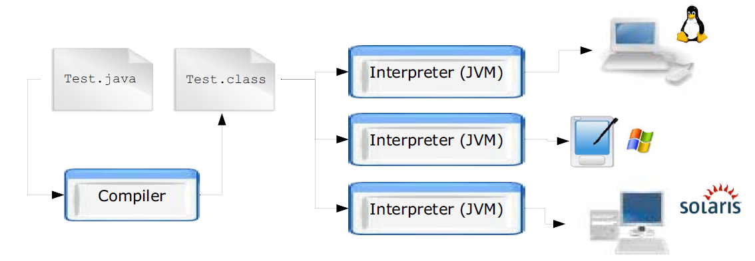
Compiling and Executing a Java Program
Java programs are compiled to Java byte-codes, a kind of machine independent representation. The program is then executed by an interpreter called the Java Virtual Machine (JVM).

Slide 9
Taking Input in Java.
Using Java Command Line Arguments.
Using Scanner Class.

Slide 10
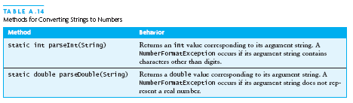
Converting Numeric Strings to Numbers

Slide 11
Input/Output using Streams
An InputStream is a sequence of characters representing program input data
An OutputStream is a sequence of characters representing program output
The console keyboard stream is System.in
The console window is associated with System.out

Slide 12
Creating and Using Objects
Declaration - DataType identifier
Rectangle r1;
Creation - new operator and specified constructor
r1 = new Rectangle();
Rectangle r2 = new Rectangle();
new keyword in Java
The new keyword is used to allocate memory at runtime. All objects get memory in Heap memory area.

Slide 13
public static void main(string[] args) in Java
public: The public modifier makes it accessible from anywhere in the application.
static: The static modifier makes it a class method so that it can be called using the class name without creating an object of the class.
void: The return type of the main method is void which means that it does not return a value to its caller. You must specify void when you declare the main method.
main: It is the name of a method where execution will start. In Java, the main method is called by JVM.
String[ ] args: The main method accepts one argument of type String array (String[ ]). The square brackets [ ] represent the array of strings that is passed as an argument to this method. args is the name of its parameter. You can use any parameter name as you wish.

Slide 14
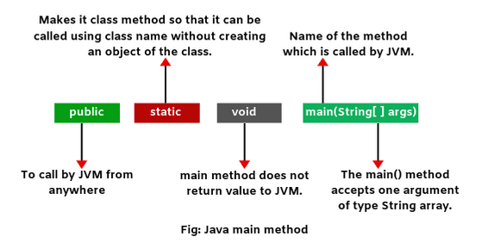
public static void main(string[] args) in Java

Slide 15
Basic Features
Data Types
Primitives
Classes / Objects
Expressions and Operators
Control Structures
Arrays
Methods

Slide 16
Primitive Data Types
Represent numbers, characters, Boolean values.
Integers: byte, short, int, and long
Real numbers: float and double
Characters: char

Slide 17
Data Type | Characteristics | Range
byte | 8 bit signed integer | -128 to 127
short | 16 bit signed integer | -32768 to 32767
int | 32 bit signed integer | -2,147,483,648 to 2,147,483,647
long | 64 bit signed integer | -9,223,372,036,854,775,808 to- 9,223,372,036,854,775,807
float | 32 bit floating point number | + 1.4E-45 to + 3.4028235E+38
double | 64 bit floating point number | + 4.9E-324 to + 1.7976931348623157E+308
boolean | true or false | NA, note Java booleans cannot be converted to or from other types
char | 16 bit, Unicode | Unicode character, \u0000 to \uFFFF Can mix with integer types

Slide 18
//dataType identifier;
int x;
int y = 10;
int z, zz;
double a = 12.0;
boolean done = false, prime = true;
char mi = 'D';

Slide 19
Operators
pre/post-increment ++ --, boolean complement !, bitwise complement ~, unary + -, type cast (type), object creation new
* / %
binary + - (+ also concatenates strings)
signed shift << >>, unsigned shift >>>
comparison < <= > >=
equality comparison == !=
bitwise and &
bitwise or |

Slide 20
logical (sequential) and &&
logical (sequential) or ||
conditional cond ? true-expr : false-expr
assignment =, compound assignment += -= *= /= <<= >>= >>>= &= |=

Slide 21
Control Statements
Java provides three types of control flow statements.
Decision Making statements
if statements
switch statement
Loop statements
do while loop
while loop
for loop
for-each loop
Jump statements
break statement
continue statement

Slide 22
Lets’ Talk About
Arrays
An array is a group of like-typed variables that are referred to by a common name. Arrays in Java work differently than they do in C/C++.
Strings
Strings in Java are Objects that are backed internally by a char array. Strings are immutable as well.
Methods
A method is a block of code which only runs when it is called. You can pass data, known as parameters, into a method.

Slide 23
THANKS!
Any questions?

